Slide 1
My Shave of the Day
Department of Computer and Information Sciences | Towson University
James Rehak
COSC 880 | Dr. Josh Dehlinger

Slide 2
Outline
Motivation
Technologies
Tools
Architecture
Demonstration
Experiences
Future Work
Notes:
Motivation, the problem, why I choose to do this project.
The tools I used to solve this problem.
The technologies involved in the implementation.
The Architecture of my software project
A quick demo

Slide 3
Problem / Motivation
Everyday millions of men shave
Chore vs Ritual
Show off one’s facial hair
Need Expense and experience tracking
Mobile App to track shaving habits
SCORE Project Topic
2 Core Functionalities
My Shave of the day
Shave Den
Notes:
Every day, millions of men in the world remove their facial hair: for some this is a chore, for others it is a ritual. Wet shaving enthusiasts perform this ritual by using a combination of tools, ranging from hardware (shaving brush and razor) to software (shaving cream/soap and aftershave).
The daily choice of these tools makes the SOTD (Shave of the Day), which is often shared online with other wet shavers.
In this project, I developed a mobile app that keeps track of the SOTDs of the user, as well as of his collection of tools.
SCORE = Student Contest on Software Engineering

Slide 4
My Shave of the day
Create Shaving Records
Description
Picture
Items used
Rating
Date Created
Share record to a social media platform

Slide 5
The Shave Den
The Database
Shaving related items
Name
Picture
Purchase date
Price
Number of uses
Grouped by Categories
Shaving history

Slide 6
Technologies
Mobile Web Application
Portability
Expandable
Ruby on Rails
Good Support
Heroku Web Server
Minimize configuration Errors
Focus on development
PostgreSQL
Heroku Constraint
Android
Web client
Additional Visibility
Notes:
Also mention physical harm safe for web app

Slide 7
Tools
Version Control
Subversion → GitHub
GIT → Heroku
IDE
RubyMine
Android Studio

Slide 8
User Requirements
The user shall be able to create a shaving record for SOTD.
The user shall be able to track their shaving expenses.
The user shall be able to browse his shaving history and can edit or delete it.
The user shall be able to share data with other shavers, via social media platform.
The user shall be able to create an item category.
The user shall be able to categorize and store shaving items in the ‘shave den’ database.
The user shall be able to view items from the ‘shave den’ database and can edit of delete the selected item.
The user shall be able to view and alter shaving categories in the database.
The user shall be able to track his frequency of usage of a selected item.
The user shall be able to register an account.
The user shall be able to login with a registered account.

Slide 9
Architecture - Model View Controller
Client
Controller
View
Model
Shave Den DB
Notes:
Design Patterns are great, prevent cowboy coding.
First Database project, application layer was one class, everything combine.

Slide 10
Architecture
Model
User
Shaving Record
Item
Shaving Item
Category
Identity
View
Users
Shaving Records
Items
Categories
Expenses
Devise
Home
Layouts
Controller
Application_controller
User_controller
Shaving_Records_controller
Items_controller
Categories_controller
Expense_controller
Tweets_controller
Omniauth_callbacks_controller
Home_controller

Slide 11
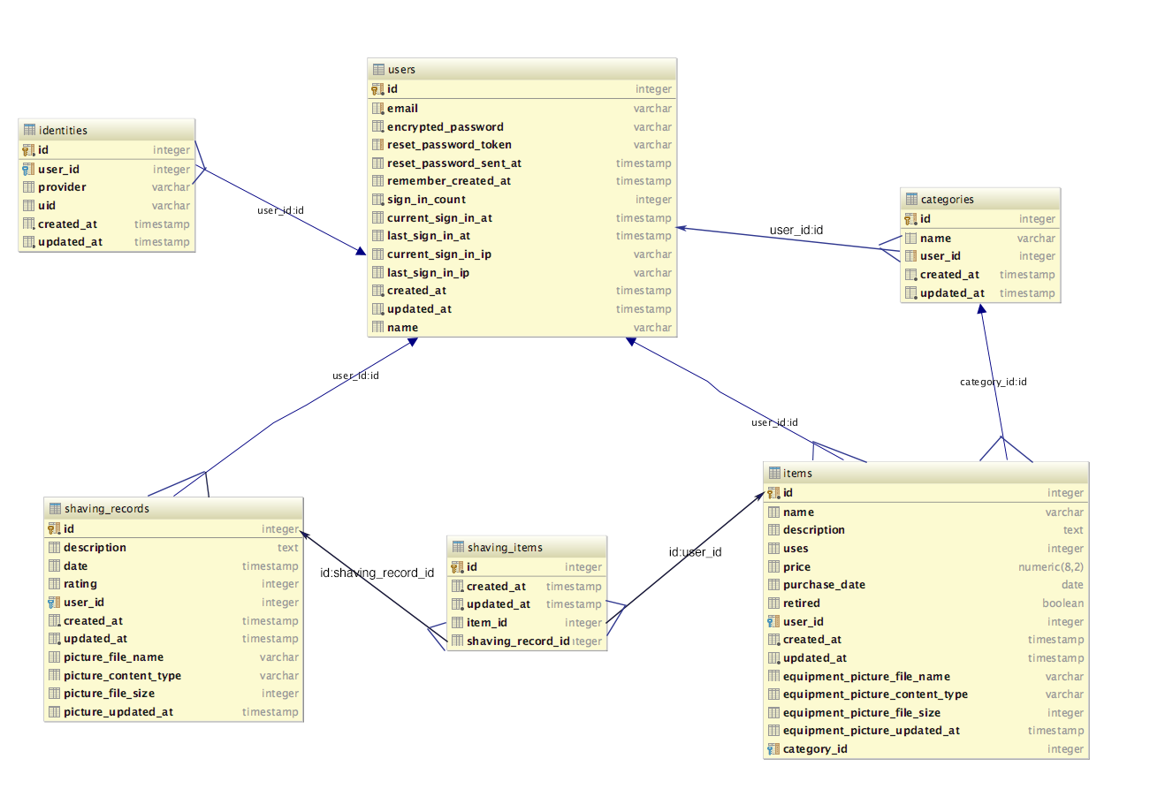
Datebase Design
Notes:
All entities belong to the user

Slide 12
Gems
Paperclip – image upload
Devise – User Authentication
Omniauth – User Authentication using social media
Twitter – Ruby Interface to Twitter API
Bootstrap - UI

Slide 13

Android Thin Client
Android Library – WebView
Enabled Settings
Javascript
Caching
Allow file access
Permission to access camera

Slide 14
Demonstration Time!

